Slide 1
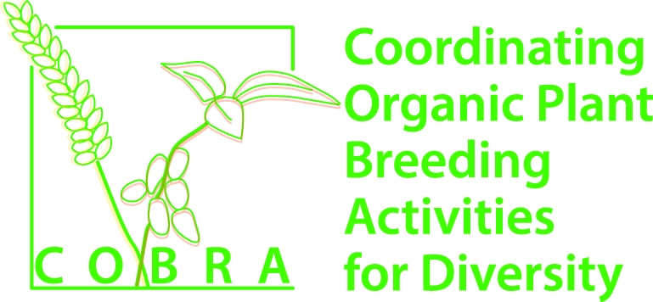
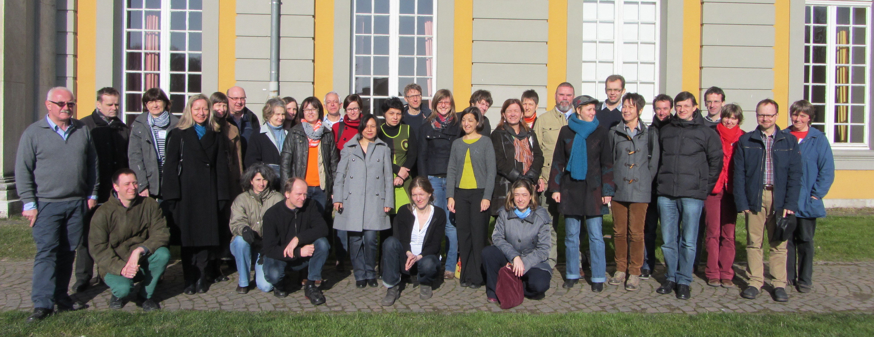
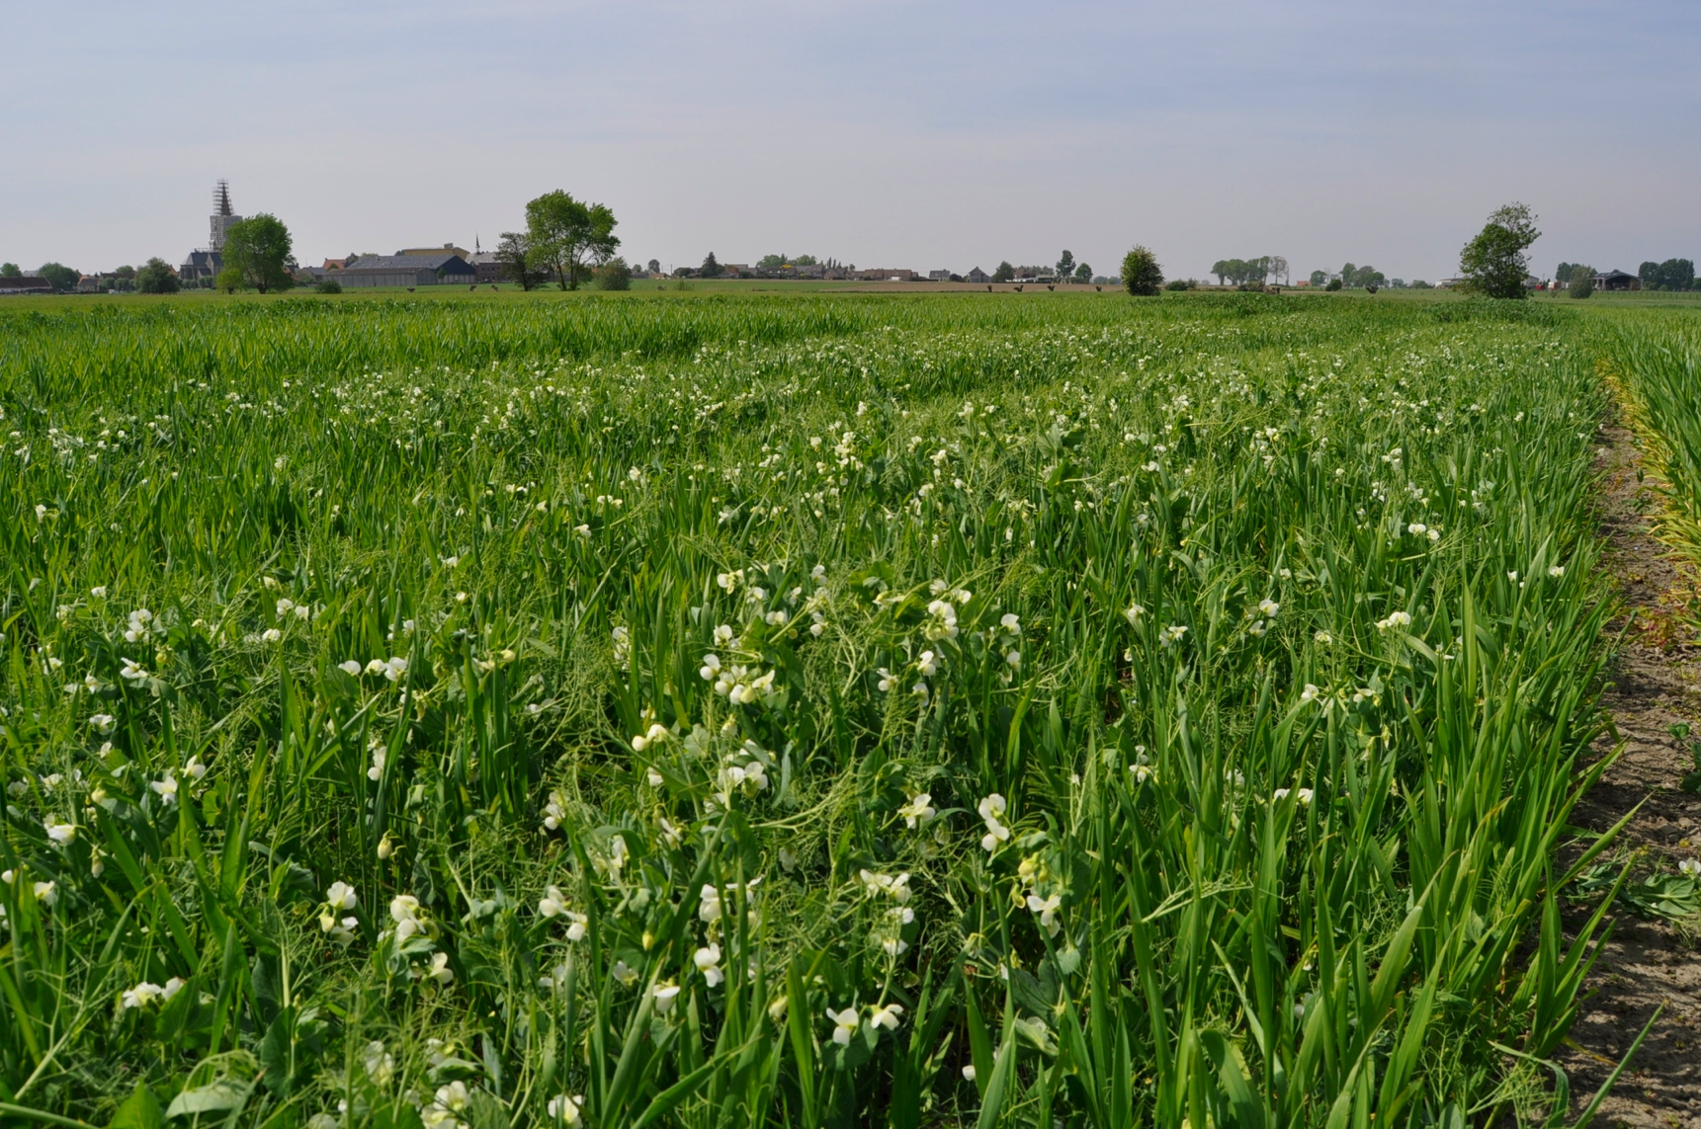
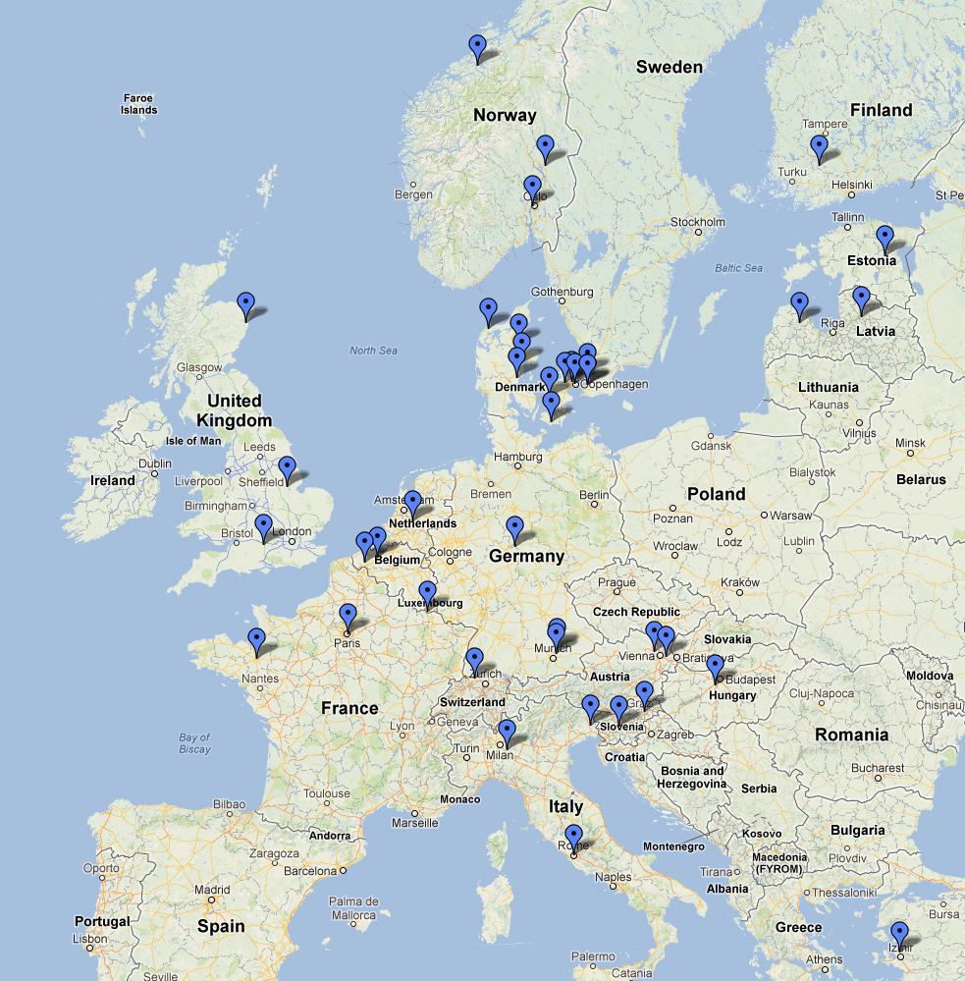
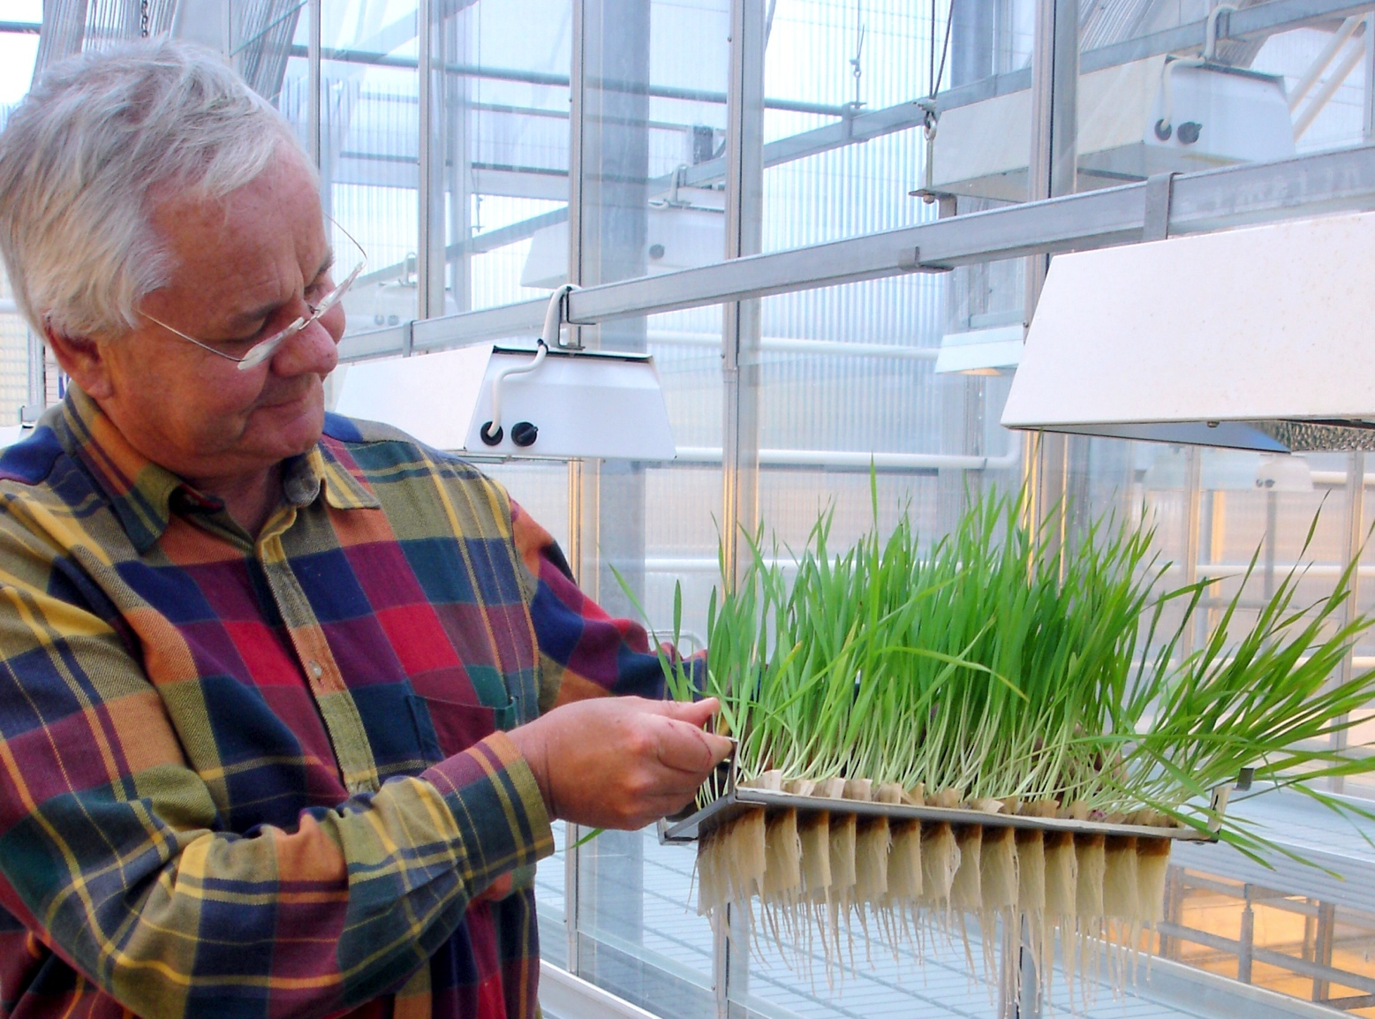
COBRA: Coordinating Organic Plant Breeding Activities for Diversity
Dr Bruce D Pearce (coordinator). The Organic Research Centre, UK.
Organic farming, despite its past successes, faces major challenges. A key problem is the lack of suitable plant varieties adapted to the specific conditions of organic systems. This issue can only be resolved if organic plant breeding efforts are better coordinated and the potential of plant genetic diversity is unlocked.
A new 3 year, €3M project called COBRA is funded by the CORE Organic II funding bodies and will address this by bringing together 41 partners (from industry as well as research) from 18 European countries to pool their expertise and experience.
COBRA will work with a number of arable crops including cereals (wheat & barley) and grain legumes (pea & faba bean).
COBRA aims to support and develop organic plant breeding and seed production in Europe with a focus on increasing the use and potential of plant material with High genetic Diversity (Hi-D), such as Composite Cross Populations (CCPs) and other genotype mixtures through coordinating, linking and expanding existing breeding and research.
It will address five problem areas:
issues of seed health;
response to multiple stresses, acting simultaneously on the crops;
improvements inbreeding efficiency;
structural issues such as funding for breeding and the regulatory framework; and
networking and coordination
Financial support for this project provided by the CORE Organic II Funding Bodies, being partners of the FP7 ERA-Net project, CORE Organic II (Coordination of European Transnational Research in Organic Food and Farming systems, project no. 249667).

